Slide 1

ISE 218: Fundamentals of Information Technology
Unit 6: Input/Output Systems
Spring 2025
Instructor: Abid Malik
co-Instructor: Xinrui Yu

Slide 2
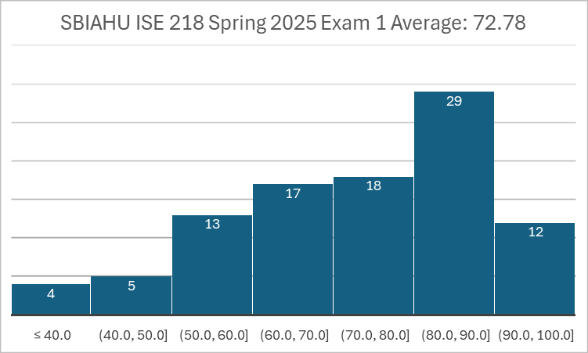
Exam 1 Grade Distribution

Slide 3
Introduction
Data storage and retrieval are two of the primary functions of computer systems.
  One could argue that computers are more useful to us as data storage and retrieval devices than they are as computational machines.
All computers have I/O devices connected to them, and to achieve good performance I/O should be kept to a minimum!
In studying I/O, we seek to understand different types of I/O devices, as well as how they work.

Slide 4
I/O and Performance
Sluggish I/O throughput can have a ripple effect, dragging down overall system performance.
  This is especially true when virtual memory is involved because it depends heavily on disk I/O
The fastest processor in the world is of little use if it spends most of its time waiting for data.
If we really understand what’s happening in a computer system we can make the best possible use of its resources.

Slide 5
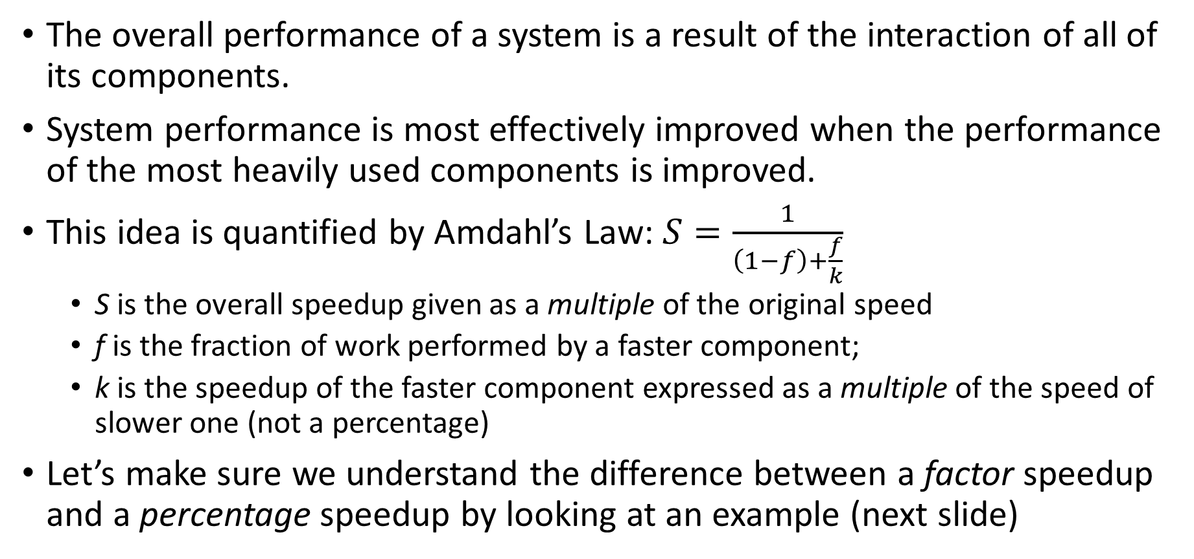
Amdahl’s Law
The overall performance of a system is a result of the interaction of all of its components.
System performance is most effectively improved when the performance of the most heavily used components is improved.
This idea is quantified by Amdahl’s Law: $S=\frac{1}{\left(1−f\right)+\frac{f}{k}}$
  S is the overall speedup given as a multiple of the original speed
  f is the fraction of work performed by a faster component;
  k is the speedup of the faster component expressed as a multiple of the speed of slower one (not a percentage)
Let’s make sure we understand the difference between a factor speedup and a percentage speedup by looking at an example (next slide)

Slide 6
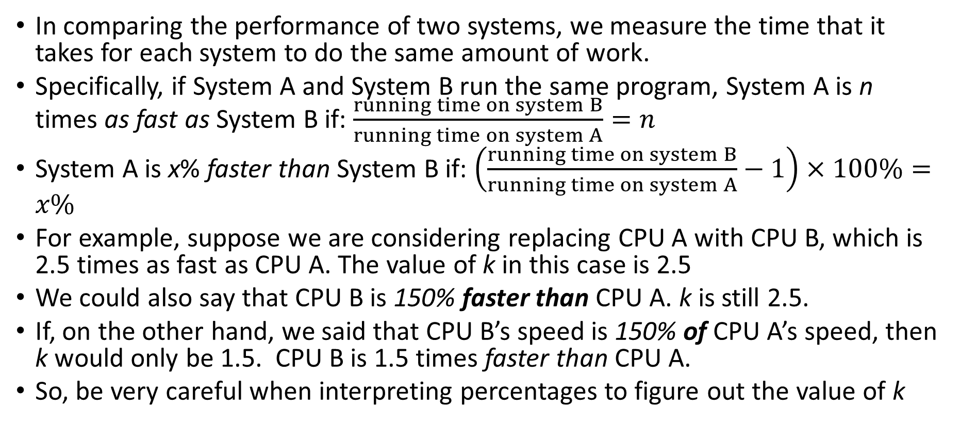
Amdahl’s Law
In comparing the performance of two systems, we measure the time that it takes for each system to do the same amount of work.
Specifically, if System A and System B run the same program, System A is n times as fast as System B if: $\frac{running time on system B}{running time on system A}=n$
System A is x% faster than System B if: $\left(\frac{running time on system B}{running time on system A}−1\right)×100\%=x\%$
For example, suppose we are considering replacing CPU A with CPU B, which is 2.5 times as fast as CPU A. The value of k in this case is 2.5
We could also say that CPU B is 150% faster than CPU A. k is still 2.5.
If, on the other hand, we said that CPU B’s speed is 150% of CPU A’s speed, then k would only be 1.5. CPU B is 1.5 times faster than CPU A.
So, be very careful when interpreting percentages to figure out the value of k

Slide 7
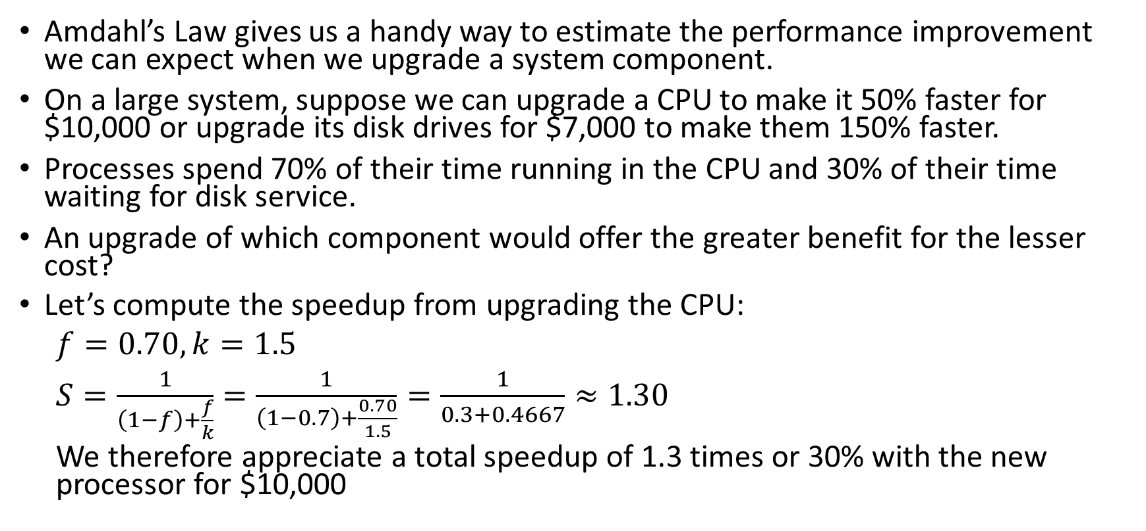
Amdahl’s Law: Example #1
Amdahl’s Law gives us a handy way to estimate the performance improvement we can expect when we upgrade a system component.
On a large system, suppose we can upgrade a CPU to make it 50% faster for $10,000 or upgrade its disk drives for $7,000 to make them 150% faster.
Processes spend 70% of their time running in the CPU and 30% of their time waiting for disk service.
An upgrade of which component would offer the greater benefit for the lesser cost?
Let’s compute the speedup from upgrading the CPU:
$f=0.70, k=1.5$
$S=\frac{1}{\left(1−f\right)+\frac{f}{k}}=\frac{1}{\left(1−0.7\right)+\frac{0.70}{1.5}}=\frac{1}{0.3+0.4667}≈1.30$
We therefore appreciate a total speedup of 1.3 times or 30% with the new processor for $10,000

Slide 8
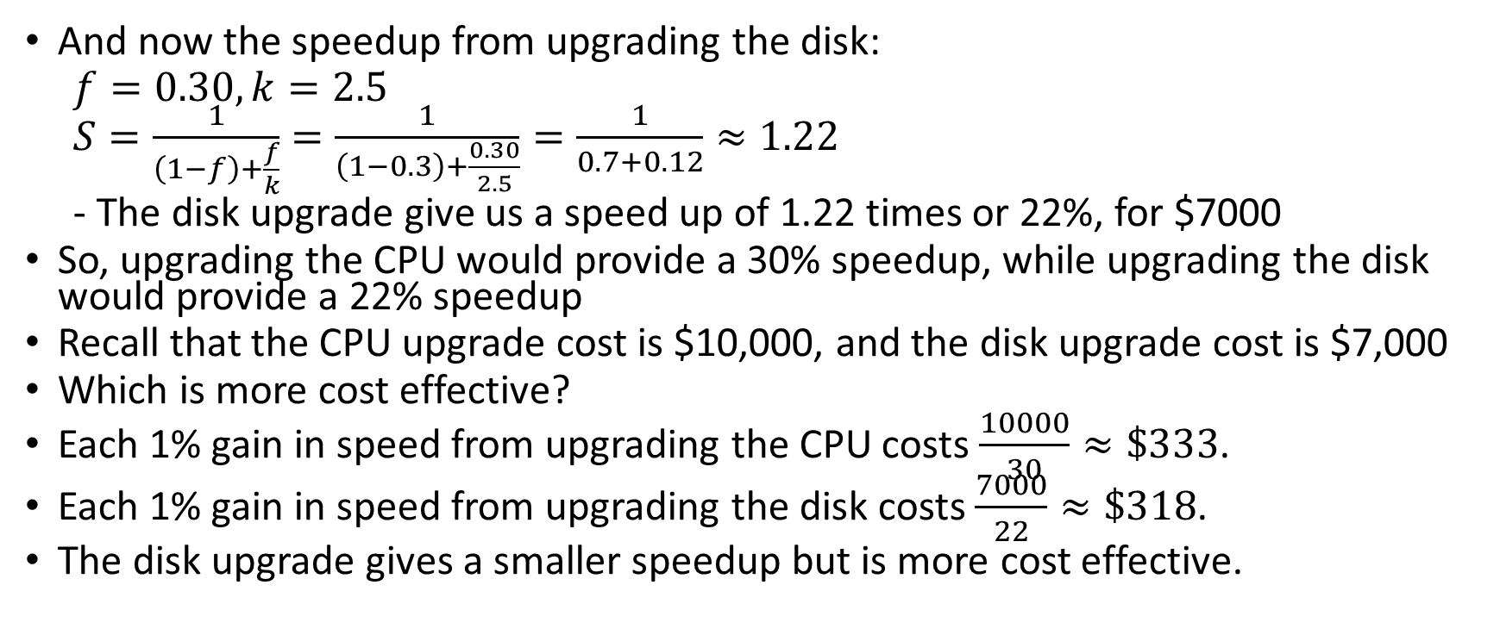
Amdahl’s Law: Example #1
And now the speedup from upgrading the disk:
$f=0.30, k=2.5$
$S=\frac{1}{\left(1−f\right)+\frac{f}{k}}=\frac{1}{\left(1−0.3\right)+\frac{0.30}{2.5}}=\frac{1}{0.7+0.12}≈1.22$
- The disk upgrade give us a speed up of 1.22 times or 22%, for $7000
So, upgrading the CPU would provide a 30% speedup, while upgrading the disk would provide a 22% speedup
Recall that the CPU upgrade cost is $10,000, and the disk upgrade cost is $7,000
Which is more cost effective?
Each 1% gain in speed from upgrading the CPU costs $\frac{10000}{30}≈\$333$.
Each 1% gain in speed from upgrading the disk costs $\frac{7000}{22}≈\$318$.
The disk upgrade gives a smaller speedup but is more cost effective.

Slide 9
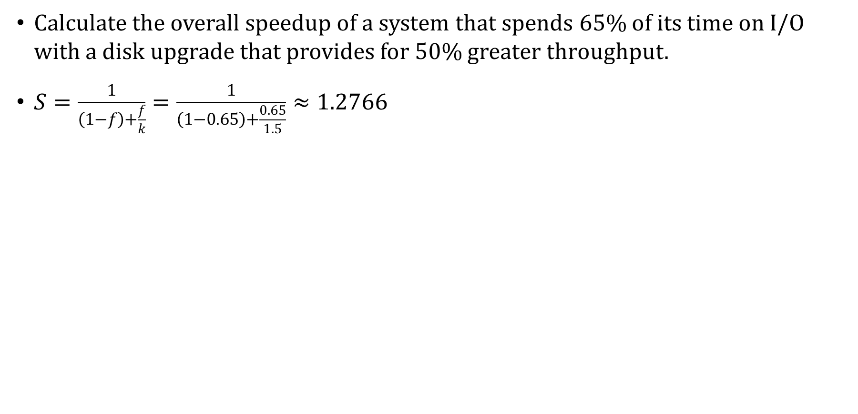
Amdahl’s Law: Example #2
Calculate the overall speedup of a system that spends 65% of its time on I/O with a disk upgrade that provides for 50% greater throughput.
$S=\frac{1}{\left(1−f\right)+\frac{f}{k}}=\frac{1}{\left(1−0.65\right)+\frac{0.65}{1.5}}≈1.2766$

Slide 10
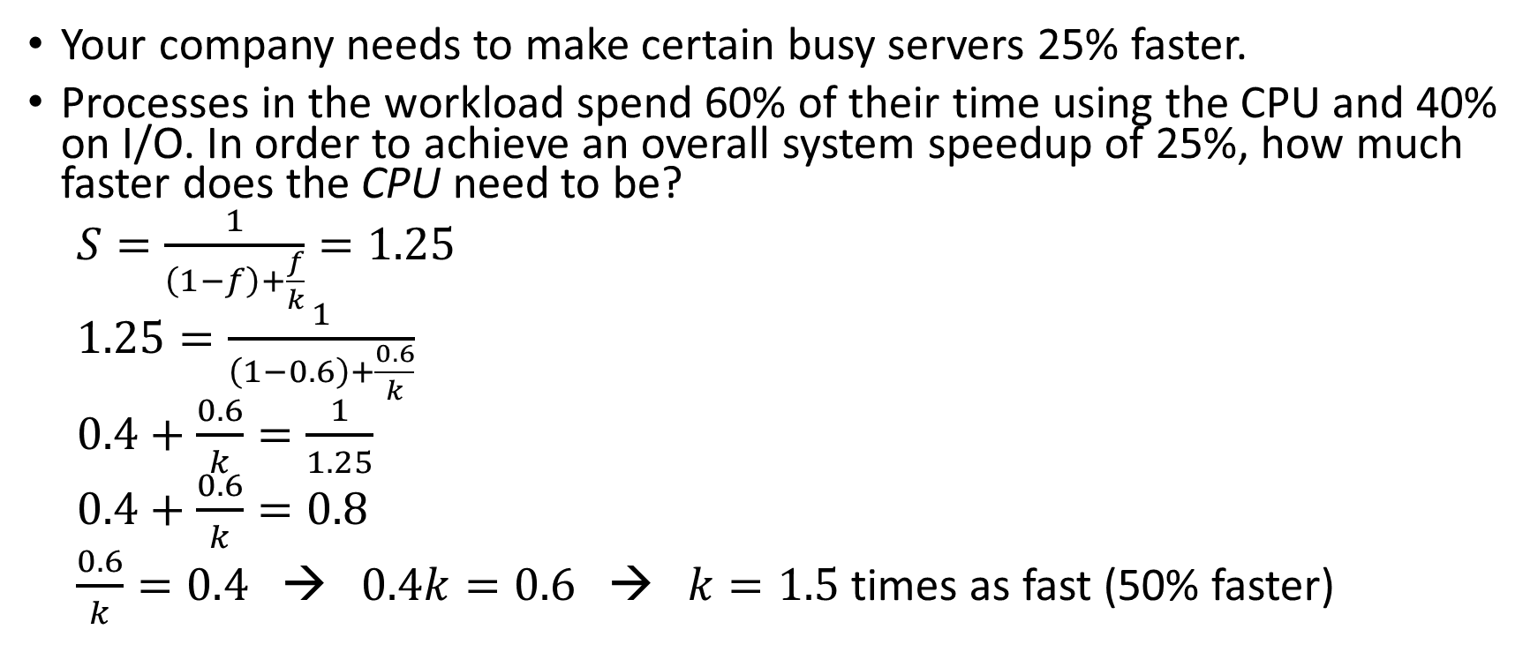
Amdahl’s Law: Example #3
Your company needs to make certain busy servers 25% faster.
Processes in the workload spend 60% of their time using the CPU and 40% on I/O. In order to achieve an overall system speedup of 25%, how much faster does the CPU need to be?
$S=\frac{1}{\left(1−f\right)+\frac{f}{k}}=1.25$
$1.25=\frac{1}{\left(1−0.6\right)+\frac{0.6}{k}}$
$0.4+\frac{0.6}{k}=\frac{1}{1.25}$
$0.4+\frac{0.6}{k}=0.8$
$\frac{0.6}{k}=0.4$ → $0.4k=0.6$ → $k=1.5$ times as fast (50% faster)

Slide 11
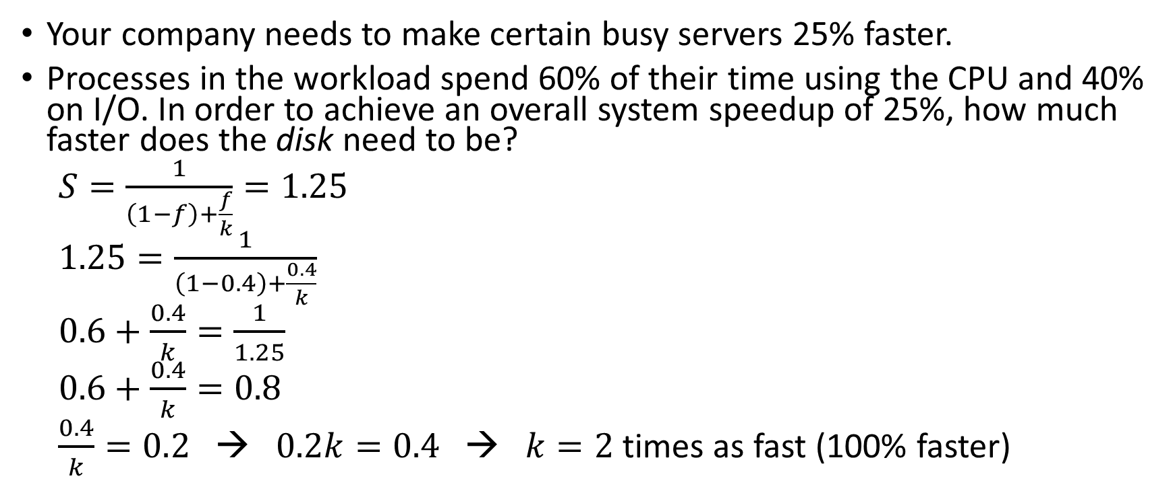
Amdahl’s Law: Example #4
Your company needs to make certain busy servers 25% faster.
Processes in the workload spend 60% of their time using the CPU and 40% on I/O. In order to achieve an overall system speedup of 25%, how much faster does the disk need to be?
$S=\frac{1}{\left(1−f\right)+\frac{f}{k}}=1.25$
$1.25=\frac{1}{\left(1−0.4\right)+\frac{0.4}{k}}$
$0.6+\frac{0.4}{k}=\frac{1}{1.25}$
$0.6+\frac{0.4}{k}=0.8$
$\frac{0.4}{k}=0.2$ → $0.2k=0.4$ → $k=2$ times as fast (100% faster)

Slide 12
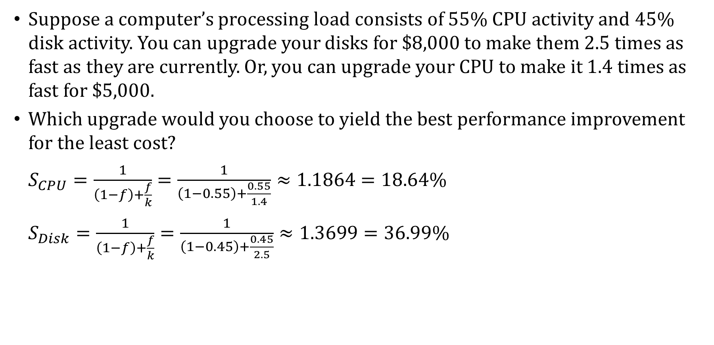
Amdahl’s Law: Example #5
Suppose a computer’s processing load consists of 55% CPU activity and 45% disk activity. You can upgrade your disks for $8,000 to make them 2.5 times as fast as they are currently. Or, you can upgrade your CPU to make it 1.4 times as fast for $5,000.
Which upgrade would you choose to yield the best performance improvement for the least cost?
$S_{CPU}=\frac{1}{\left(1−f\right)+\frac{f}{k}}=\frac{1}{\left(1−0.55\right)+\frac{0.55}{1.4}}≈1.1864=18.64\%$
$S_{Disk}=\frac{1}{\left(1−f\right)+\frac{f}{k}}=\frac{1}{\left(1−0.45\right)+\frac{0.45}{2.5}}≈1.3699=36.99\%$

Slide 13
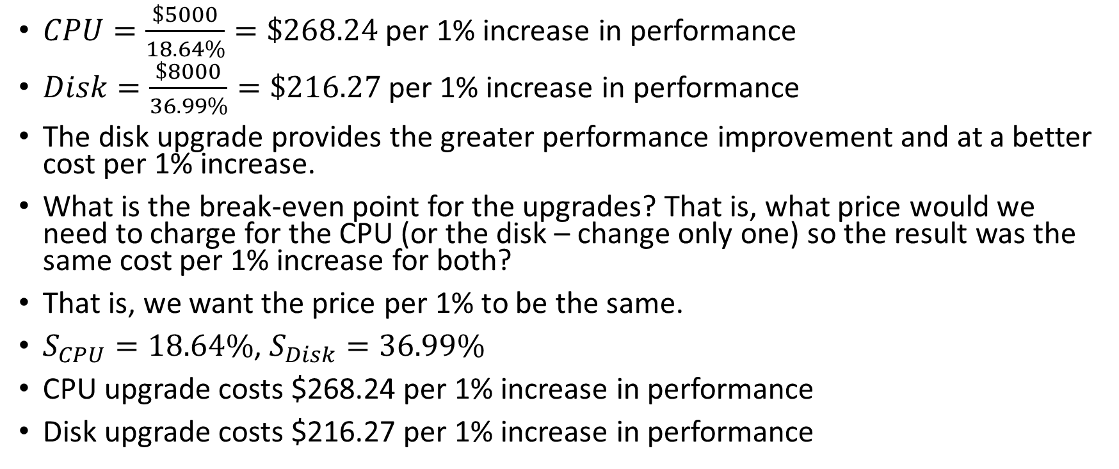
Amdahl’s Law: Example #5
$CPU=\frac{\$5000}{18.64\%}=\$268.24$ per 1% increase in performance
$Disk=\frac{\$8000}{36.99\%}=\$216.27$ per 1% increase in performance
The disk upgrade provides the greater performance improvement and at a better cost per 1% increase.
What is the break-even point for the upgrades? That is, what price would we need to charge for the CPU (or the disk – change only one) so the result was the same cost per 1% increase for both?
That is, we want the price per 1% to be the same.
$S_{CPU}=18.64\%$, $S_{Disk}=36.99\%$
CPU upgrade costs $268.24 per 1% increase in performance
Disk upgrade costs $216.27 per 1% increase in performance

Slide 14
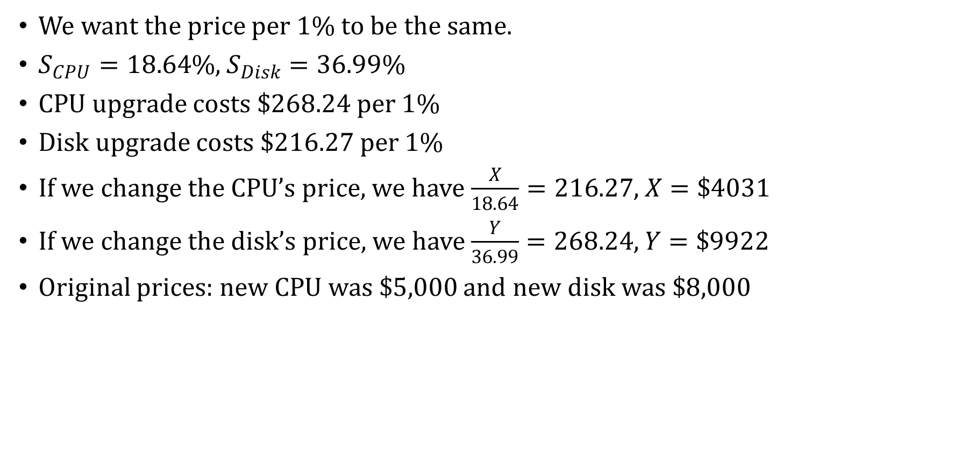
Amdahl’s Law: Example #5
We want the price per 1% to be the same.
$S_{CPU}=18.64\%$, $S_{Disk}=36.99\%$
CPU upgrade costs $268.24 per 1%
Disk upgrade costs $216.27 per 1%
If we change the CPU’s price, we have $\frac{X}{18.64}=216.27$, $X=\$4031$
If we change the disk’s price, we have $\frac{Y}{36.99}=268.24$, $Y=\$9922$
Original prices: new CPU was $5,000 and new disk was $8,000

Slide 15
I/O Architectures
We define input/output as a subsystem of components that moves coded data between external devices and a host system.
I/O subsystems include:
  Blocks of main memory that are devoted to I/O functions.
  Buses that move data into and out of the system.
  Control modules in the host and in peripheral devices
  Interfaces to external components such as keyboards and disks.
  Cabling or communications links between the host system and its peripherals.

Slide 16
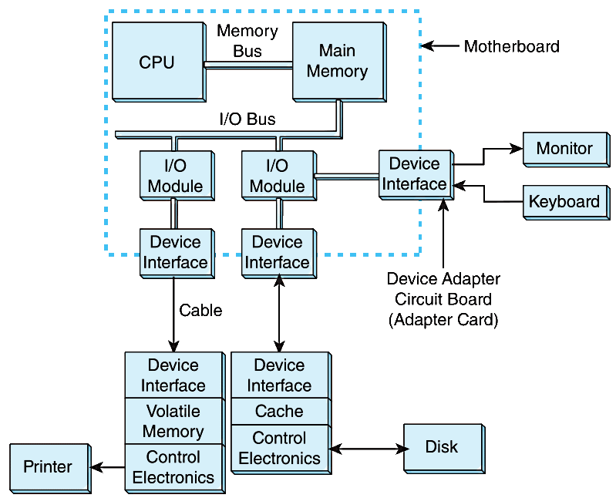
I/O Architectures
This figure shows an integrated I/O subsystem
Slower I/O devices like printers need to buffer the data sent to them by the CPU

Slide 17
I/O Architectures
Communication between devices is defined by a set of rules called a protocol
As an example, one rule might be that the receiver acknowledge commands and data sent to it
  “I am ready for your data!”
  “I received your data!”
This type of protocol, when the two parties establish the communication parameters before communicating, is called a handshake protocol

Slide 18
I/O Architectures
I/O can be controlled in five general ways:
  Programmed I/O reserves a register for each I/O device. Each register is continually polled by the CPU to detect data arrival.
  Interrupt-Driven I/O allows the CPU to do other things until I/O is requested.
  Memory-Mapped I/O shares memory address space between I/O devices and program memory.
  Direct Memory Access (DMA) offloads I/O processing to a special-purpose chip that takes care of the details.
  Channel I/O uses dedicated I/O processors.

Slide 19
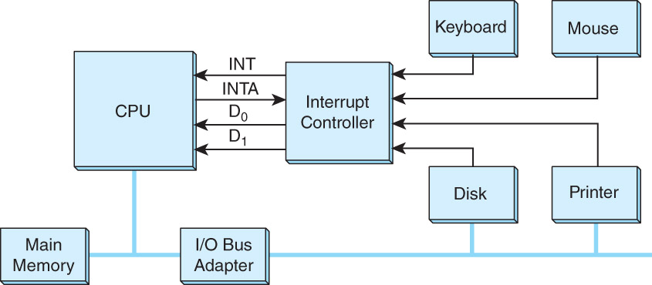
Interrupt-driven I/O
Below is an idealized I/O subsystem that uses interrupts.
Each device connects its interrupt line to the interrupt controller.

Slide 20
Interrupt-driven I/O
The controller signals the CPU on the Interrupt (INT) line when any of the interrupt lines are asserted.
The CPU asserts the Interrupt Acknowledge (INTA) signal to tell the interrupt controller that it got the message and will start processing the interrupt.

Slide 21
Interrupt-driven I/O
Recall that in a system that uses interrupts, the status of the interrupt signal is checked at the start of the fetch-decode-execute cycle.
The particular code that is executed whenever an interrupt occurs is determined by a set of addresses called interrupt vectors that are stored in main memory.
An interrupt vector points to the device driver code that processes the interrupt.
The system state is saved before the interrupt service routine is executed and is restored afterward. Flowchart on the next slide.

Slide 22
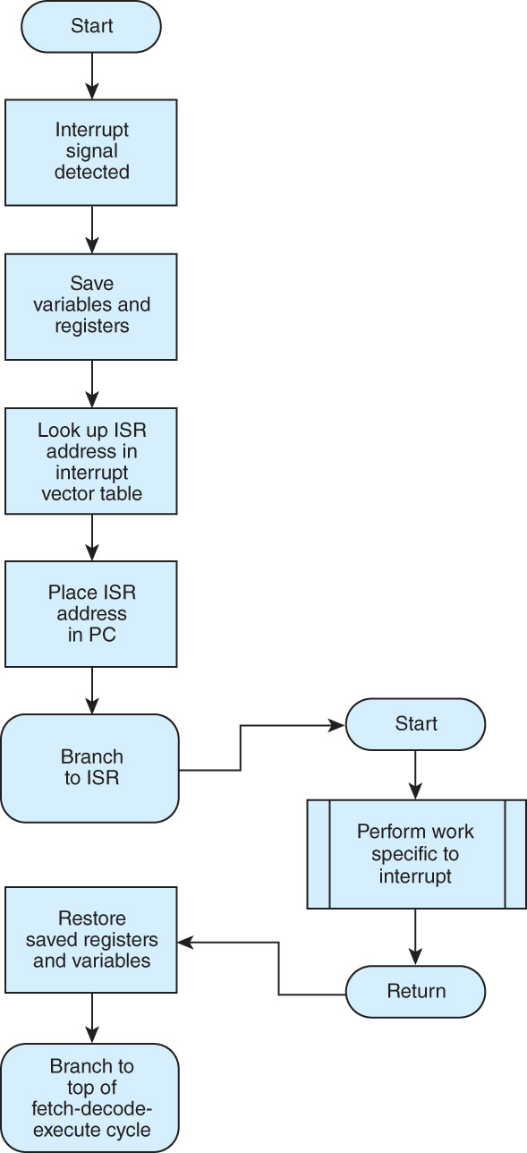
Interrupt-driven I/O

Slide 23
Memory-mapped I/O
In memory-mapped I/O, devices and main memory share the same address space.
Each I/O device has its own reserved block of memory.
Memory-mapped I/O therefore looks just like a memory access from the point of view of the CPU.
Thus the same instructions are used to move data to and from both I/O and memory, greatly simplifying system design.
Each I/O device controller monitors the CPU’s address bus to see if the CPU is accessing a memory address assigned to the device

Slide 24
Direct Memory Access
In DMA, the CPU offloads execution of simple I/O instructions to a dedicated DMA controller
The CPU gives the DMA controller the details of the I/O request (location and number of bytes to transfer, destination device or memory address)
The DMA controller executes the request, writing the data directly to main memory
When the I/O is complete, the DMA sends an interrupt signal to the CPU, so the CPU can process the data
The CPU and DMA controller share the system bus, so when the DMA controller is using the system bus for memory transfers we call it cycle stealing because the CPU can’t use the system bus itself during that time to perform other I/O operations or access main memory

Slide 25
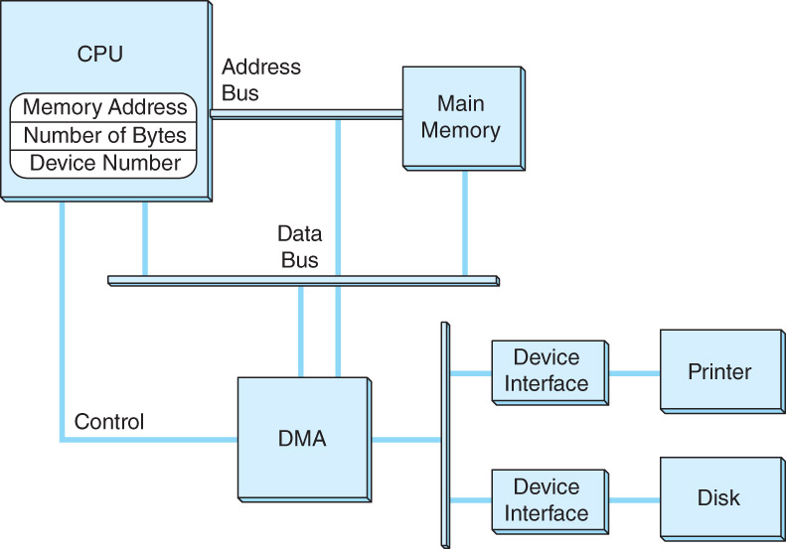
Direct Memory Access
This is a DMA configuration. Notice that the DMA controller and the CPU share the data bus.
The DMA runs at a higher priority and steals memory cycles from the CPU.

Slide 26
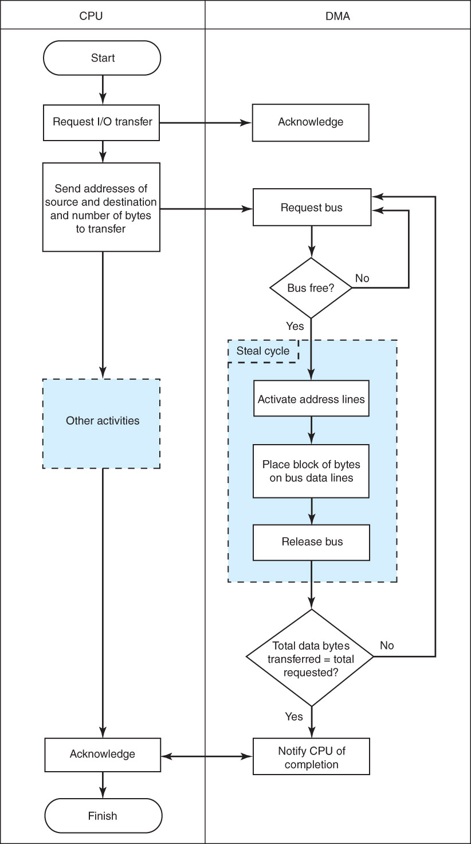
Direct Memory Access
(continued at top of next column)

Slide 27
Channel I/O
Very large systems employ channel I/O, which is a form of DMA used on mainframe computers and file servers.
Channel I/O consists of one or more I/O processors (IOPs) that control various channel paths.
Slower devices such as terminals and printers are combined (multiplexed) into a single faster channel.
Channel I/O is distinguished from DMA by the “intelligence” of the IOPs.
The IOP negotiates protocols, issues device commands, translates storage coding to memory coding (i.e., data formats), and can transfer entire files independent of the host CPU.
The host has only to create the program instructions for the I/O operation and tell the IOP where to find them.

Slide 28
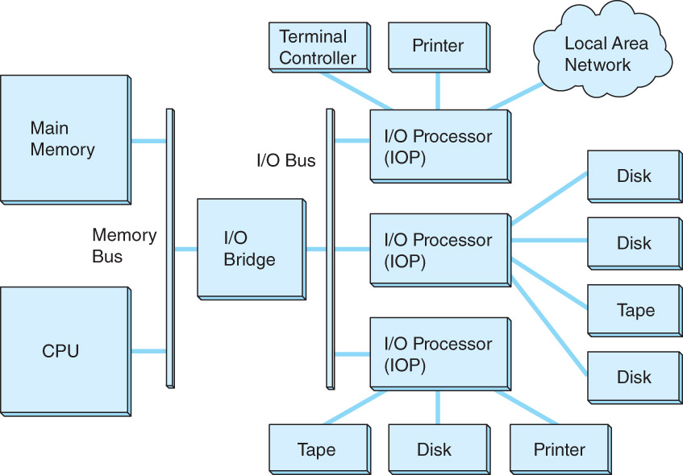
Channel I/O
Like DMA, channel I/O uses cycle stealing, but unlike DMA, uses the system bus only to fetch its instructions from the main memory.
A dedicated I/O bus is used to transfer the actual data between I/O devices
(e.g., disk → tape).

Slide 29
Character I/O vs. Block I/O
Character I/O devices process one byte (or character) at a time.
  Examples include modems, keyboards, and mice.
  Keyboards are usually connected through an interrupt-driven I/O system.
Block I/O devices handle bytes in groups.
  Most mass storage devices (disk and tape) are block I/O devices.
  Block I/O systems are most efficiently connected through DMA or channel I/O, which handle large data transfers efficiently.

Slide 30
I/O Architectures
By having a separate bus for main memory, memory transfers can be made synchronous
  Use some multiple of the CPU’s clock cycles to retrieve data from main memory
I/O buses, unlike memory buses, operate asynchronously. Requests for bus access must be arbitrated among the devices involved.
A bus clock coordinates communication between the DMA controller and the various I/O devices

Slide 31
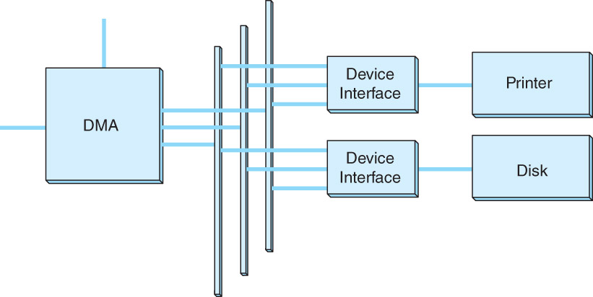
I/O Architectures
This is a generic DMA configuration showing how the DMA circuit connects to address, data and control buses.

Slide 32
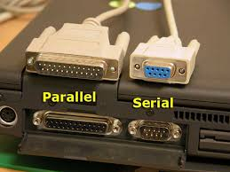
Data Transmission Modes
Bytes can be conveyed from one point to another by sending their encoding signals simultaneously using parallel data transmission or by sending them one bit at a time in serial data transmission.
In parallel data transmission, the interface requires one wire for each bit.
Parallel cables are fatter than serial cables.
Compared with parallel data interfaces, serial communications interfaces:
  Require fewer conductors (wires), making them cheaper.
  Are less susceptible to attenuation (loss of signal strength), which is caused when multiple wires are adjacent to each other (as in parallel cables).
  Can transmit data farther and faster more reliably.
With parallel transmission the multiple bits might not arrive at exactly the same time, further complicating matters

Slide 33
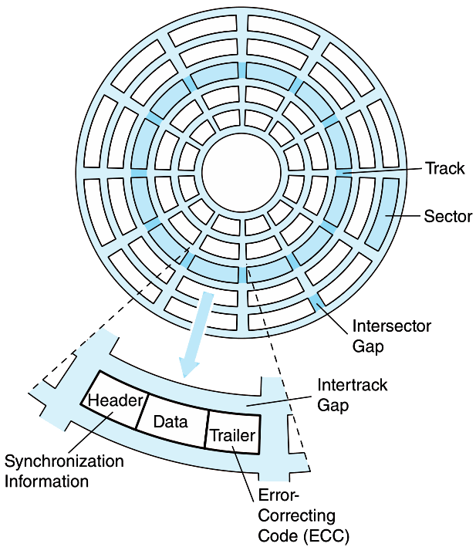
Magnetic Disk Technology
Magnetic disks offer large amounts of durable storage that can be accessed quickly.
Disk drives are called random (or direct) access storage devices, because blocks of data can be accessed according to their location on the disk.
  This term was coined when all other durable storage (e.g., tape) was sequentially accessed.
Disk tracks are numbered from the outside edge, starting with zero.

Slide 34
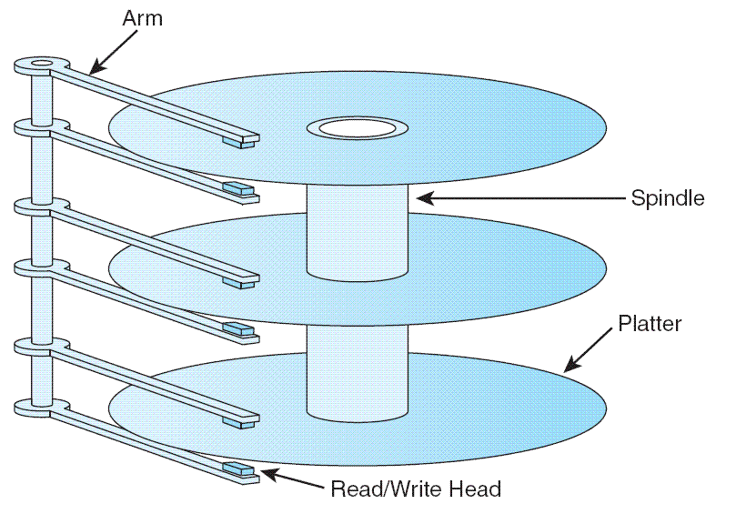
Magnetic Disk Technology
Hard disk platters are mounted on spindles.
Read/write heads are mounted on a comb that swings radially to read the disk.
The rotating disk forms a logical cylinder beneath the read/write heads.
Data blocks are addressed by their cylinder, surface, and sector.

Slide 35
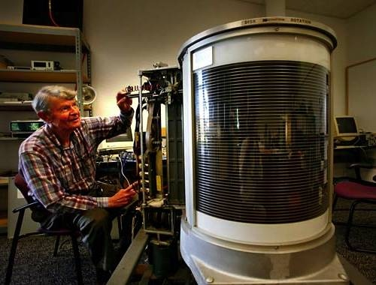
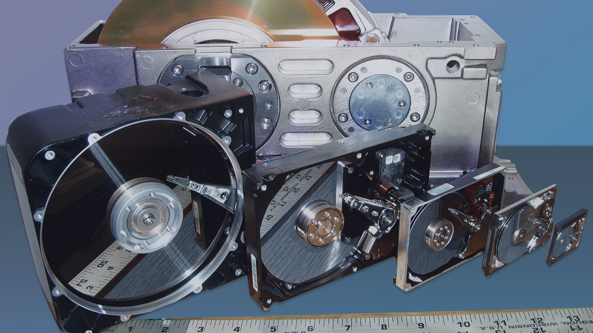
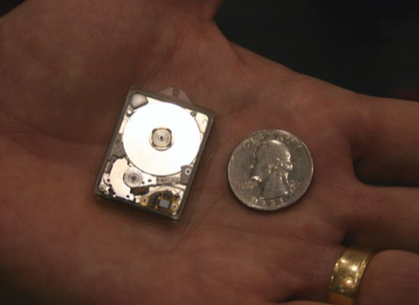

Slide 36
Magnetic Disk Technology
There are a number of electromechanical properties of hard disk drives that determine how fast its data can be accessed.
Seek time is the time that it takes for a disk arm to move into position over the desired cylinder.
Rotational delay is the time that it takes for the desired sector to move into position beneath the read/write head.
Seek time + rotational delay = access time

Slide 37
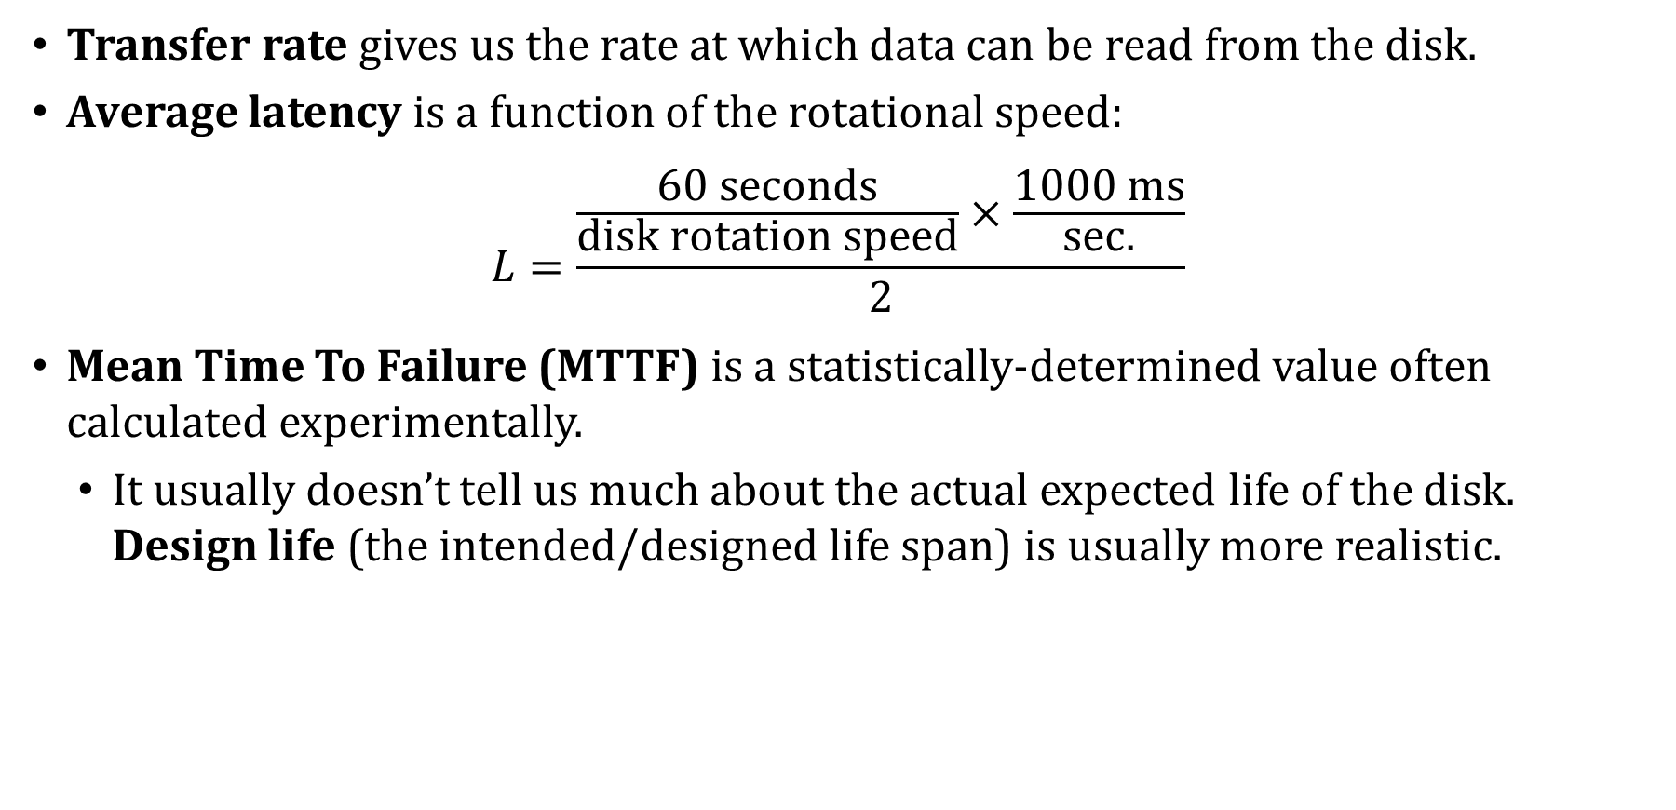
Magnetic Disk Technology
Transfer rate gives us the rate at which data can be read from the disk.
Average latency is a function of the rotational speed:
$$L=\frac{\frac{60 seconds}{disk rotation speed}×\frac{1000 ms}{sec.}}{2}$$
Mean Time To Failure (MTTF) is a statistically-determined value often calculated experimentally.
  It usually doesn’t tell us much about the actual expected life of the disk. Design life (the intended/designed life span) is usually more realistic.

Slide 38
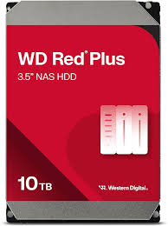
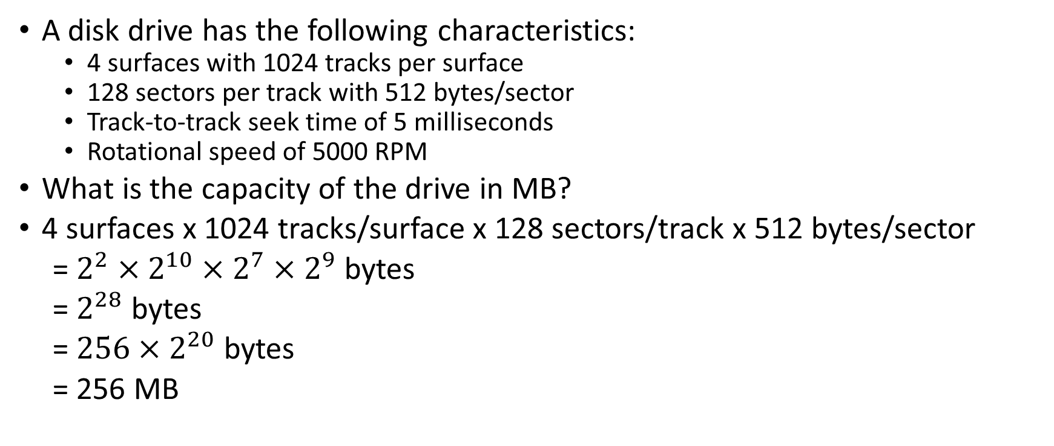
Magnetic Disks: Example #1
A disk drive has the following characteristics:
  4 surfaces with 1024 tracks per surface
  128 sectors per track with 512 bytes/sector
  Track-to-track seek time of 5 milliseconds
  Rotational speed of 5000 RPM
What is the capacity of the drive in MB?
4 surfaces x 1024 tracks/surface x 128 sectors/track x 512 bytes/sector
= $2^{2}×2^{10}×2^{7}×2^{9}$ bytes
= $2^{28}$ bytes
= $256×2^{20}$ bytes
= 256 MB
Real-life example:
Surfaces: 8
Tracks per surface: 500,000
Average sectors per track: 550
Bytes per sector: 4096
Total capacity ≈ 8 × 500,000 × 550 × 4096 bytes ≈ 9 TB

Slide 39
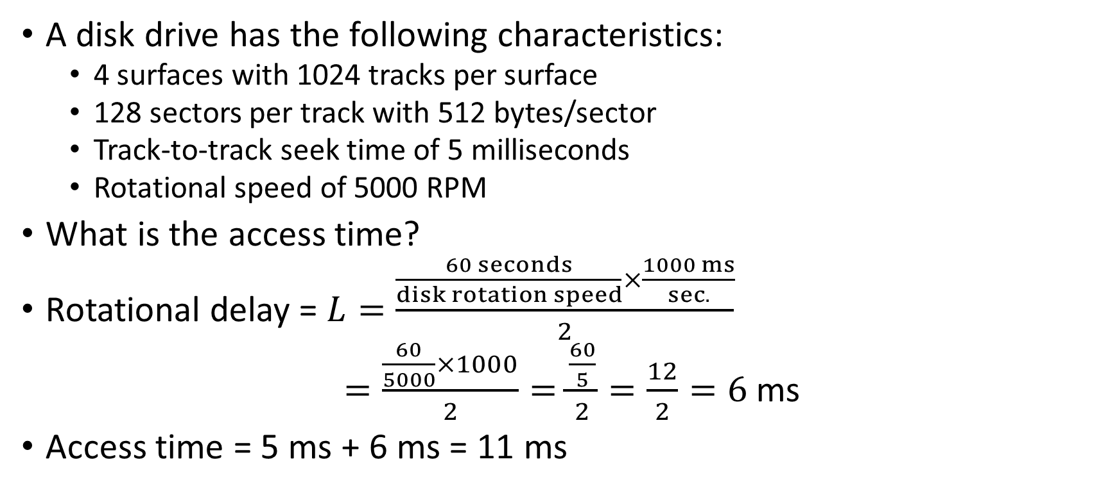
Magnetic Disks: Example #1 continued
A disk drive has the following characteristics:
  4 surfaces with 1024 tracks per surface
  128 sectors per track with 512 bytes/sector
  Track-to-track seek time of 5 milliseconds
  Rotational speed of 5000 RPM
What is the access time?
Rotational delay = $L=\frac{\frac{60 seconds}{disk rotation speed}×\frac{1000 ms}{sec.}}{2}$
$=\frac{\frac{60}{5000}×1000}{2}=\frac{\frac{60}{5}}{2}=\frac{12}{2}=6$ ms
Access time = 5 ms + 6 ms = 11 ms

Slide 40
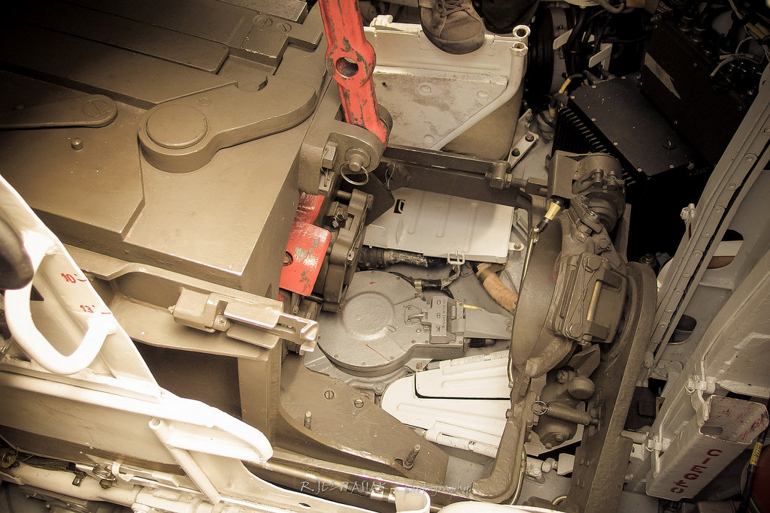
Magnetic Disk

Slide 41
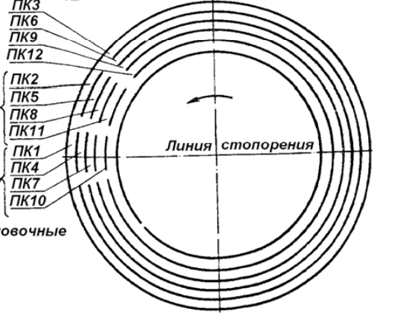
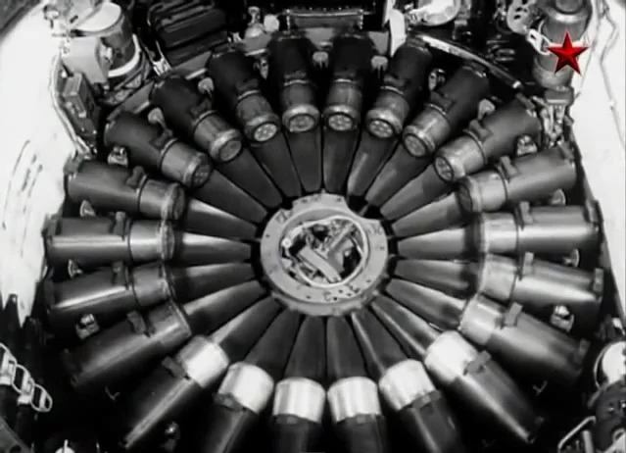
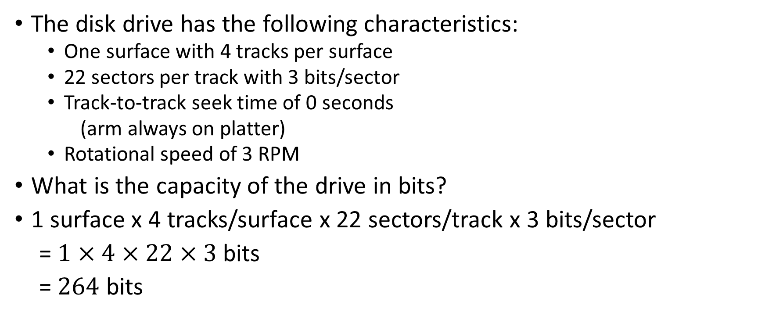
Magnetic Disks: Example #2
The disk drive has the following characteristics:
  One surface with 4 tracks per surface
  22 sectors per track with 3 bits/sector
  Track-to-track seek time of 0 seconds
  (arm always on platter)
  Rotational speed of 3 RPM
What is the capacity of the drive in bits?
1 surface x 4 tracks/surface x 22 sectors/track x 3 bits/sector
= $1×4×22×3$bits
= $264$ bits

Slide 42
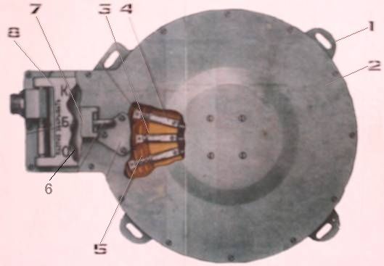
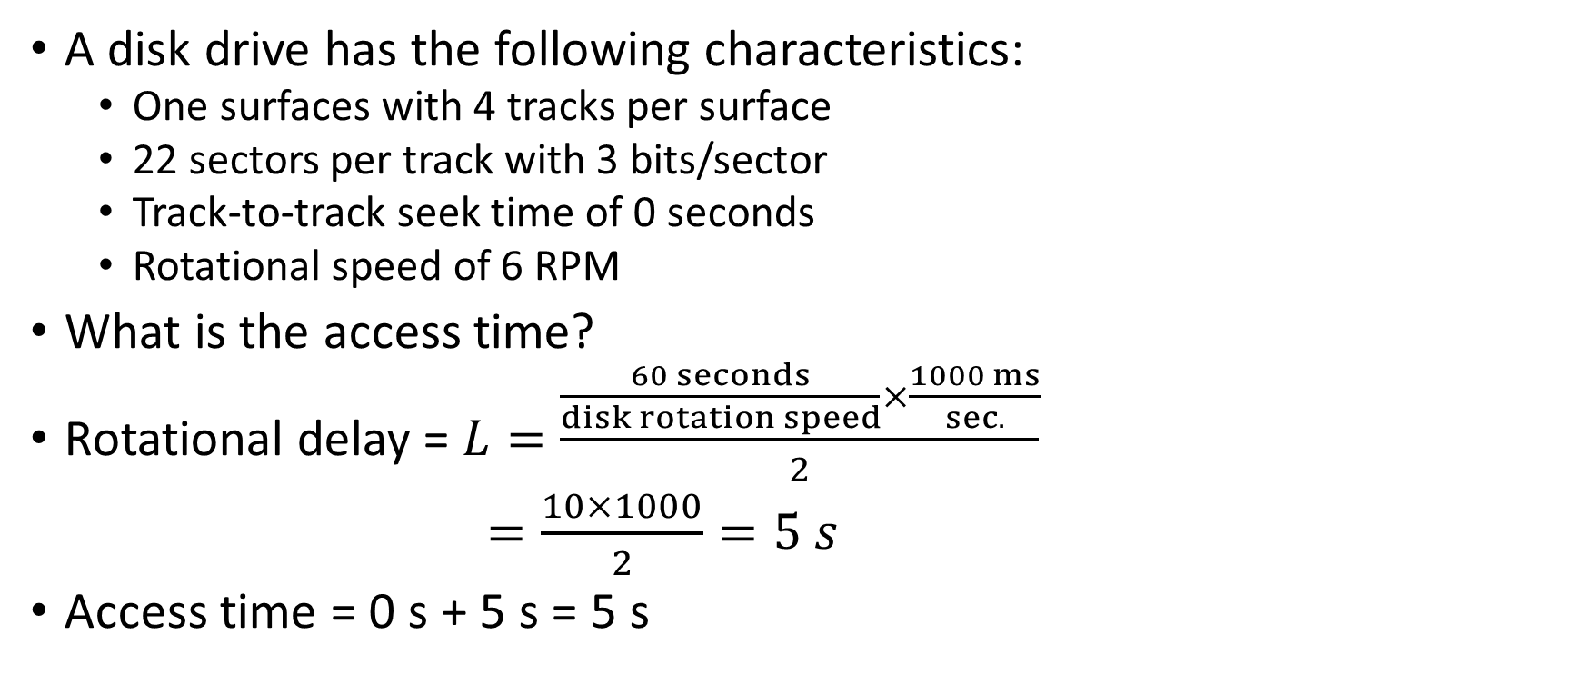
Magnetic Disks: Example #2
A disk drive has the following characteristics:
  One surfaces with 4 tracks per surface
  22 sectors per track with 3 bits/sector
  Track-to-track seek time of 0 seconds
  Rotational speed of 6 RPM
What is the access time?
Rotational delay = $L=\frac{\frac{60 seconds}{disk rotation speed}×\frac{1000 ms}{sec.}}{2}$
$=\frac{10×1000}{2}=5 s$
Access time = 0 s + 5 s = 5 s

Slide 43
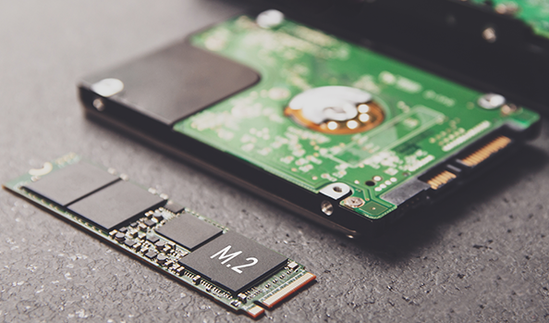
Solid State Disk Technology
Low cost is the major advantage of hard disks.
But their limitations include:
  Very slow compared to main memory
  Fragility
  Moving parts wear out
Reductions in memory cost enable the widespread adoption of solid state drives, SSDs.
  Computers “see” SSDs as just another disk drive, but they store data in non-volatile flash memory circuits.
  Flash memory is also found in memory sticks and smartphones.

Slide 44
Solid State Disk Technology
SSD access time and transfer rates are typically 100 times faster than magnetic disk, but slower than onboard RAM by a factor of 100,000.
  These numbers vary widely among manufacturers and interface methods.
Unlike RAM, flash is block-addressable (like disk drives), rather than byte-addressable
  The write endurance of flash is between 30,000 and 1,000,000 updates to a block. So, updates are spread over the entire medium through wear leveling to prolong the life of the SSD.
SSD specifications share many common metrics with HDDs (latency, data transfer rate, MTTF, others).
  Clearly, there is no need for any metrics that concern spinning platters, such as rotational delay or seek time.
Notes:
MTTF = Mean Time to Failure

Slide 45
Solid State Disk Technology
Enterprise SSDs must maintain the highest degree of performance and reliability.
  Onboard cache memories are backed up by capacitors that briefly hold a charge during a power failure, giving time to commit pending writes.
Some SSD performance and reliability metrics include:
  Unrecoverable Bit Error Ratio (UBER) and terabytes written (TBW). TBW is a measure of disk endurance (or service life) and UBER is a measure of disk reliability.
  UBER is calculated by dividing the number of data errors by the number of bits read using a simulated lifetime workload.
  TBW is the number of terabytes that can be written to the disk before the disk fails to meet specifications for speed and error rates.

Slide 46
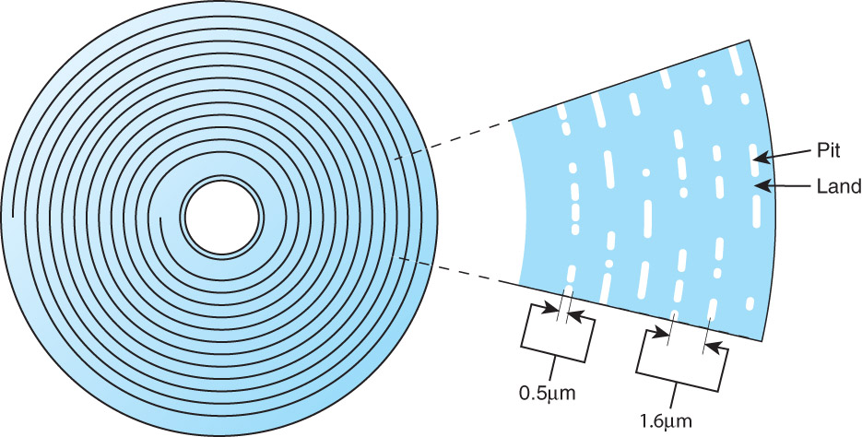
Optical Disks
Optical disks provide large storage capacities very inexpensively.
They come in a number of varieties including CD-ROM, DVD, and WORM (write once, read many).
It is estimated that optical disks can endure for a hundred years.
CD-ROMs were designed by the
music industry in the 1980s, and
later adapted to data.
This history is reflected by the fact
that data is recorded in a single
spiral track, starting from the
center of the disk and spanning
outward.

Slide 47
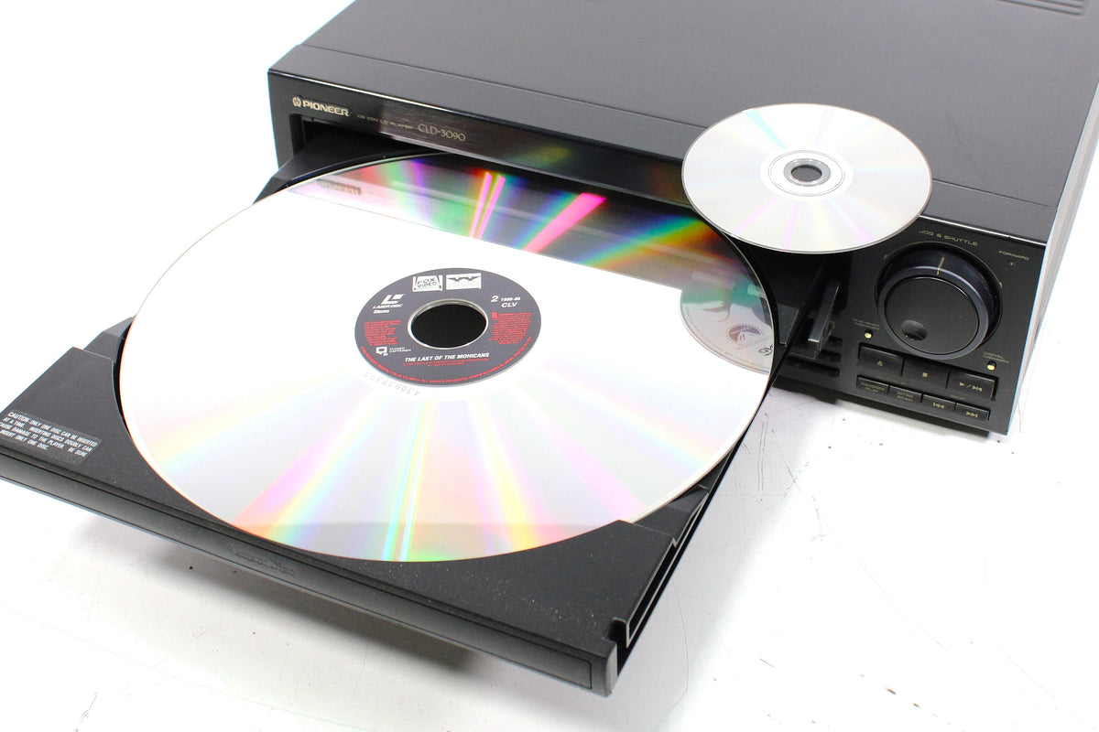
CD-ROM (1985)
D = 120 mm
Digital
Laserdisc (1978)
D = 12 inches (305 mm)
Analog

Slide 48
Optical Disks
Binary ones and zeros are delineated by bumps in the polycarbonate disk substrate. The transitions between pits and lands define binary ones.
If you could unravel a full CD-ROM track, it would be nearly five miles long!
The logical data format for a CD-ROM is much more complex than that of a magnetic disk.
Different formats are provided for
data and music.
Two levels of error correction are
provided for the data format.

Slide 49
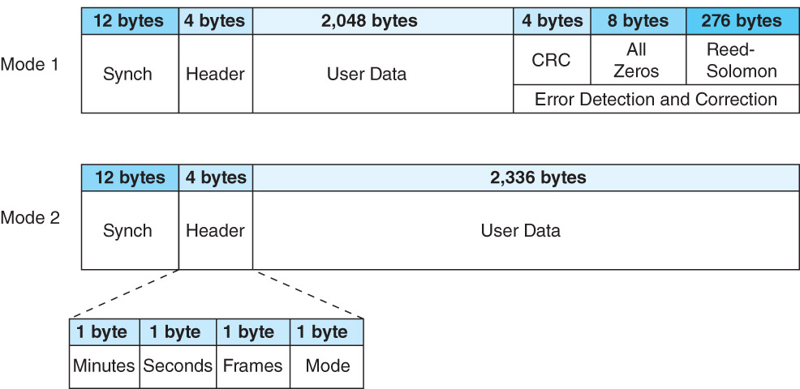
Optical Disks
Because of this, a CD holds at most 650 MB of data, but can contain as much as 742 MB of music.

Slide 50
Optical Disks
DVDs can be thought of as quad-density CDs.
  Varieties include single-sided, single-layer, single-sided double-layer, and double-sided double-layer
Where a CD-ROM can hold at most 650MB of data, DVDs can hold as much as 17GB
One of the reasons for this is that DVD employs a laser that has a shorter wavelength than the CD’s laser; another is better error-checking codes that use less space on the disc
This allows pits and lands to be closer together and the spiral track to be wound tighter.
A shorter wavelength light can read and write bytes in greater densities than can be done by a longer wavelength laser.

Slide 51
Optical Disks
The shorted wavelength is one reason that DVD’s density is greater than CD’s.
The 405 nm wavelength of blue-violet light is much shorter than either red (750 nm) or orange (650 nm).
  Used in reading Blu-ray discs
The manufacture of blue-violet lasers can now be done economically, bringing about the next generation of laser disks.
Blu-Ray was developed by a consortium of nine companies that includes Sony, Samsung, and Pioneer.
Maximum capacity of a single-layer Blu-Ray disk is 25GB.
Multiple layers can be “stacked” up to six deep.
Only double-layer disks are available for home use.

Slide 52
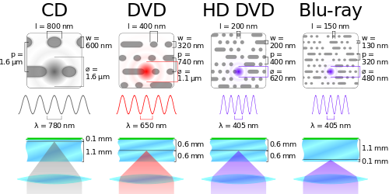
CD vs DVD vs HD-DVD vs Blu-ray

Slide 53
Magnetic Disk vs Optical Drive
Aspect | HDD | Optical Drive
Head-to-surface distance | ~1–5 nanometers (near atomic scale) | ~1 mm (laser focuses through plastic layer)
Data density | Very high; 1-2.5 TBs/Platter | Relatively low; 25-100 GBs/disk
Error tolerance | Very low (retries cause noticeable slowdown) | High (built-in strong error correction like Reed-Solomon)
Data access | Random access across densely packed platters, CAV | Sequential or semi-sequential read, CLV
Environmental sensitivity | Sensitive to shock, vibration | More robust to shock when reading

Slide 54
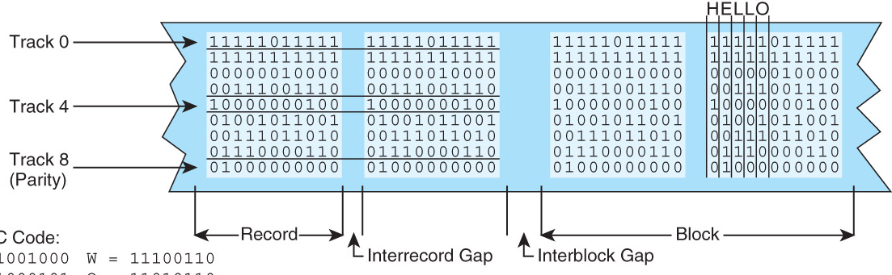
Magnetic Tape
Tape is suitable for long-term, archival data storage
First-generation magnetic tape was essentially wide analog recording tape, having capacities under 11MB.
Data was usually written in nine vertical tracks: 8 of data, 1 for error-correction information

Slide 55
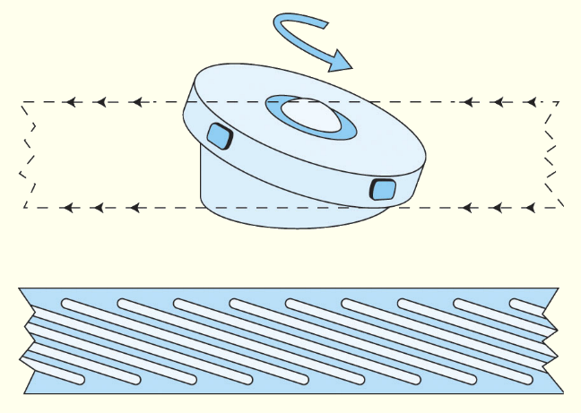
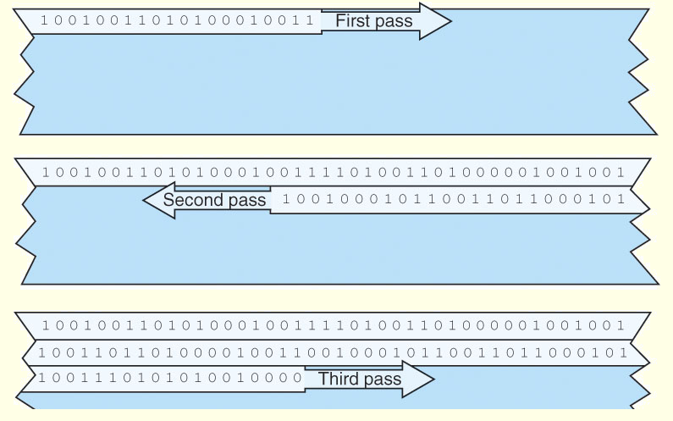
Magnetic Tape
Today’s tapes are digital, and provide multiple gigabytes of data storage.
Two dominant recording methods are serpentine and helical scan, which are distinguished by how the read-write head passes over the recording medium.

Slide 56
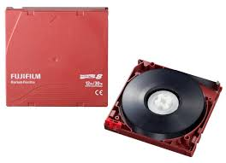
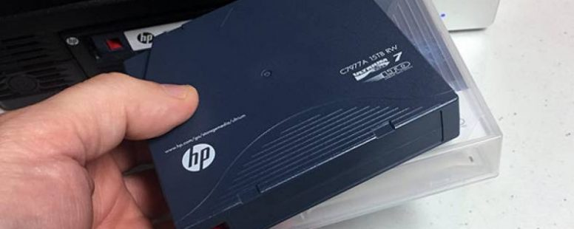
Magnetic Tape
Numerous incompatible tape formats emerged over the years.
Sometimes even different models of the same manufacturer’s tape drives were incompatible!
Finally, in 1997, HP, IBM, and Seagate collaboratively invented a best-of-breed tape standard.
They called this new tape format Linear Tape Open (LTO) because the specification is openly available.
LTO supports several levels of error correction, providing superb reliability.

Slide 57
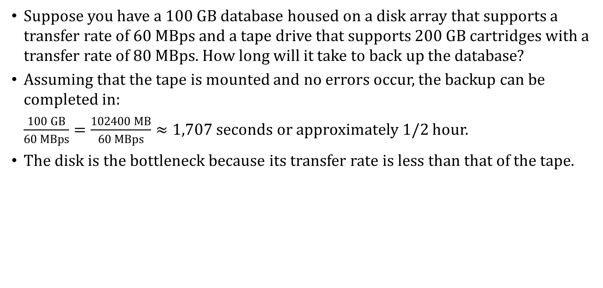
Magnetic Tape: Example
Suppose you have a 100 GB database housed on a disk array that supports a transfer rate of 60 MBps and a tape drive that supports 200 GB cartridges with a transfer rate of 80 MBps. How long will it take to back up the database?
Assuming that the tape is mounted and no errors occur, the backup can be completed in:
$\frac{100 GB}{60 MBps}=\frac{102400 MB}{60 MBps}≈1,707$ seconds or approximately 1/2 hour.
The disk is the bottleneck because its transfer rate is less than that of the tape.

Slide 58
RAID: Redundant Array of Independent Disks
RAID, an acronym for Redundant Array of Independent Disks, was invented to address problems of disk reliability, cost, and performance.
In RAID, data is stored across many disks, with extra disks added to the array to provide error correction (redundancy).
There are 7 recognized levels of RAID, but we will look at only a few of them

Slide 59
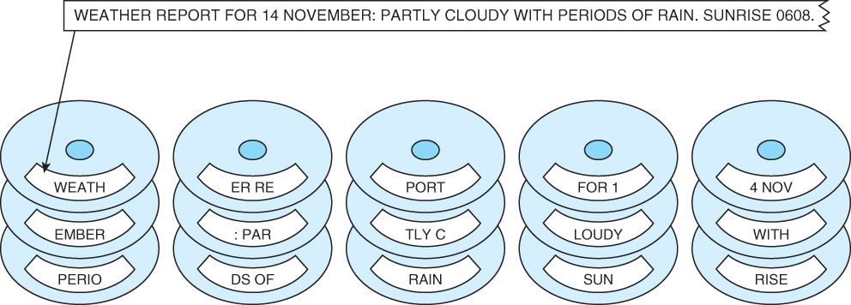
RAID Level 0
RAID Level 0, also known as drive spanning, provides improved performance, but no redundancy.
Data is written in blocks striped across the entire array of disks
The disadvantage of RAID 0 is in its low reliability.

Slide 60
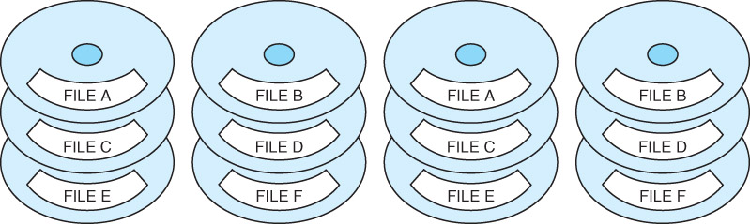
RAID Level 1
RAID Level 1, also known as disk mirroring, provides 100% redundancy, and good performance.
Two matched sets of disks contain the same data.
The disadvantage of RAID 1 is cost.
Reads are fast, but writes are slow because each write is performed twice

Slide 61
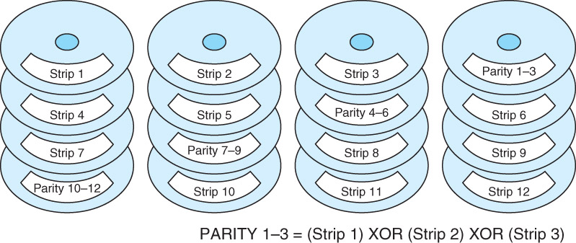
RAID Level 5
In RAID Level 5, data is written in blocks across the data disks along with parity bits distributed across disks (for error correction / data recovery).
With distributed parity, some accesses can be serviced concurrently, giving good performance and high reliability. RAID 5 is used in some commercial systems.

Slide 62
Hybrid RAID Levels
Large systems consisting of many drive arrays may employ various RAID levels, depending on the criticality of the data on the drives.
  A disk array that provides program workspace (say for file sorting) does not require high fault tolerance.
Critical, high-throughput files can benefit from combining RAID 0 with RAID 1, called RAID 10.
RAID 50 combines striping and distributed parity for good fault tolerance and high capacity.
  Note: Higher RAID levels do not necessarily mean “better” RAID levels. It all depends upon the needs of the applications that use the disks.

Slide 63
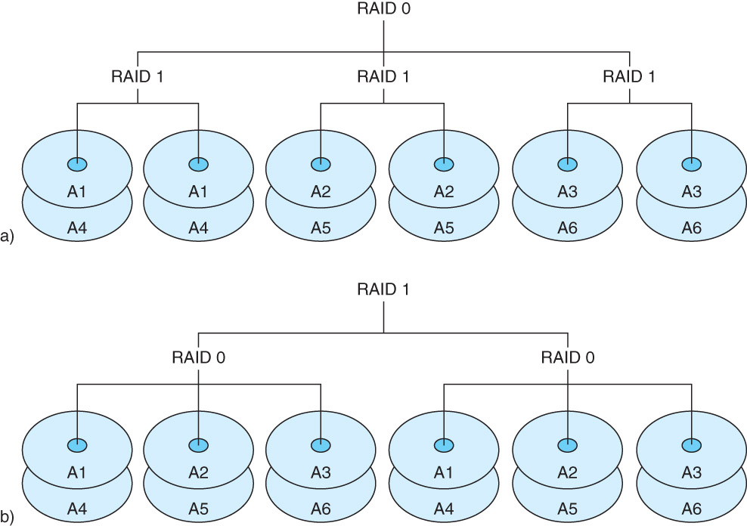
Hybrid RAID Levels
RAID 10: Stripes across mirrored pairs: could suffer 1 disk failure in each group and still work.
RAID 01: Mirror of stripes: same, but we have fewer groups, so RAID 01 is less fault tolerant than RAID 10 because we can have only two groups.

Slide 64
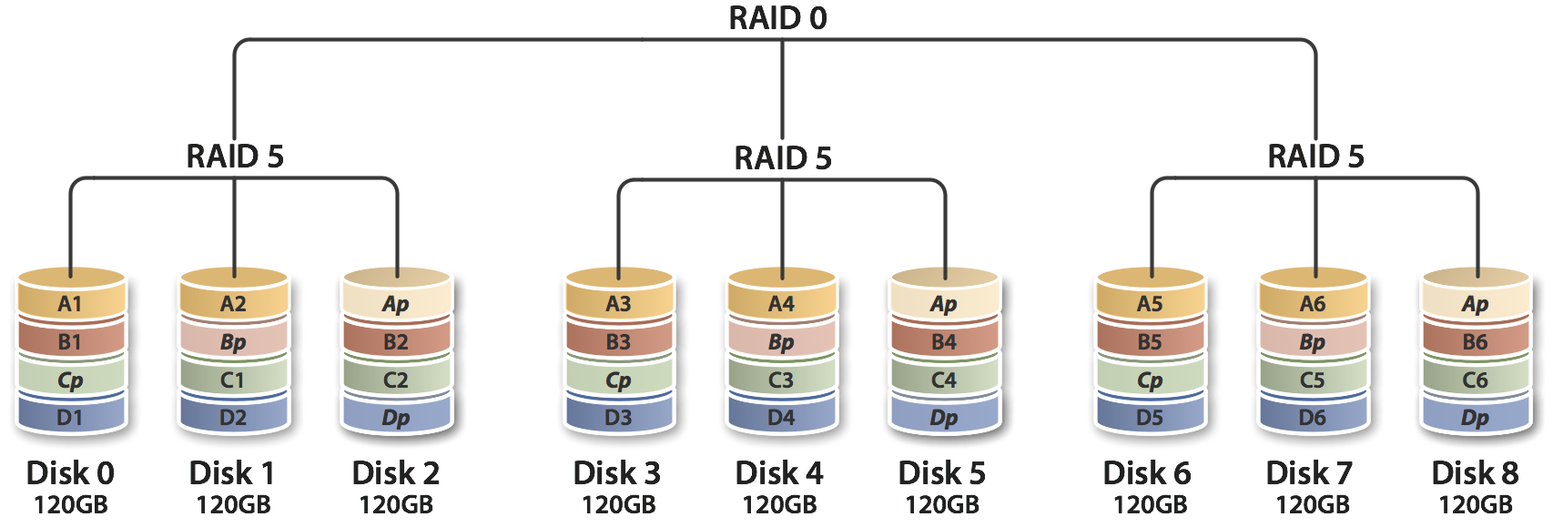
Hybrid RAID Levels
RAID 50: striping and distributed parity. Provides high reliability (the RAID 5 part) and good performance (the RAID 0 part). Can withstand one failure in each RAID 5 array simultaneously.

Slide 65
The Future of Data Storage
Advances in technology have defied all efforts to define the ultimate upper limit for magnetic disk storage.
  In the 1970s, the upper limit was thought to be around 2MB/in².
  Today’s disks commonly support 20GB/in².
Improvements have occurred in several different technologies including:
  Materials science, magneto-optical recording heads, error-correcting codes.
As data densities increase, bit cells consist of proportionately fewer magnetic grains.
There is a point at which there are too few grains to hold a value, and a 1 might spontaneously change to a 0, or vice versa.
This point is called the superparamagnetic limit.
Notes:
超顺磁极限

Slide 66
The Future of Data Storage
In 2006, the superparamagnetic limit is thought to lie between 150Gb/in² and 200Gb/in² .
Even if this limit is wrong by a few orders of magnitude, the greatest gains in magnetic storage have probably already been realized.
Future exponential gains in data storage most likely will occur through the use of totally new technologies.
Research into finding suitable replacements for magnetic disks is taking place on several fronts.
Some of the more interesting technologies include:
  Biological materials (DNA) ⦁ Carbon nanotubes
  Holographic systems
  Micro-electro-mechanical devices (nano-scale manufactured components)

